Slide 1
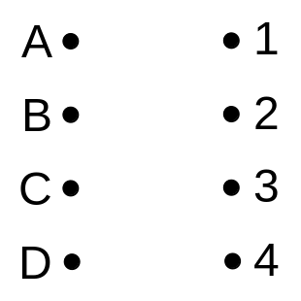






WB13 Define the terms
bipartite graph,
A graph consisting of two distinct sets of vertices X and Y in which arcs can only join a vertex in X to a vertex in Y.
Eg if A-D are four workers and 1-4 represent four tasks
The bipartite graph could represent the possible tasks each worker is able to do
(b) alternating path,
A path from an unmatched vertex in X to an unmatched vertex in Y which alternately uses arcs in/not in the matching.
Eg if A and B are initially assigned to their first task
An alternating path starts at an unmatched ‘worker’ and finishes at an unmatched ‘task’
Initial matching
Why do you think this is done?
1 does go to A
3 does go to B
C could go to 1
B could go to 4
A could go to 3

Slide 2




(c) matching,
The (1-1) matching / pairing of some elements of X with elements of Y.
Alternating path from previously:
If you ‘change status’ here:
You now have 3 matches instead of 2
An alternating path increases the number of matches by 1
This gives an improved matching:
(d) complete matching.
A 1-1 matching between all elements of X onto Y
Alternating path:
Change status:
This gives a complete matching:

Slide 3
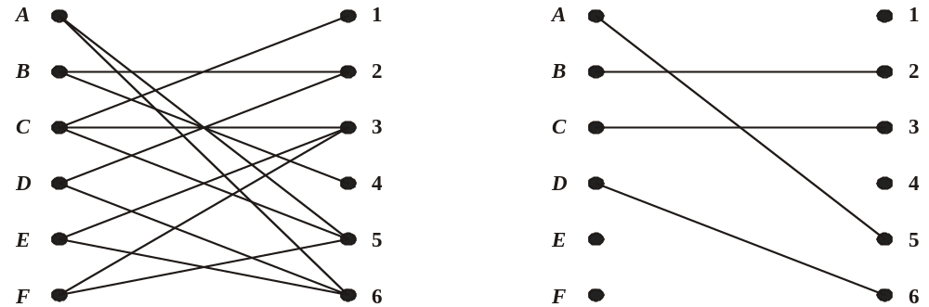
Matchings
WB14 A taxi firm has six taxis A- F, available for six journeys, 1- 6, which are booked for 9 am tomorrow.
The bipartite graph shown in Figure 1 shows the possible matchings.
Initially A, B, C and D are matched to 5, 2, 3 and 6 respectively, as indicated in Figure 2.
Figure 1
Figure 2
(a) Explain why it is necessary to perform the maximum matching algorithm twice in order to try to obtain a complete matching.
The algorithm increases the number of matches by 1 using an alternating path, and there are two unmatched nodes on each side of the initial matching.

Slide 4
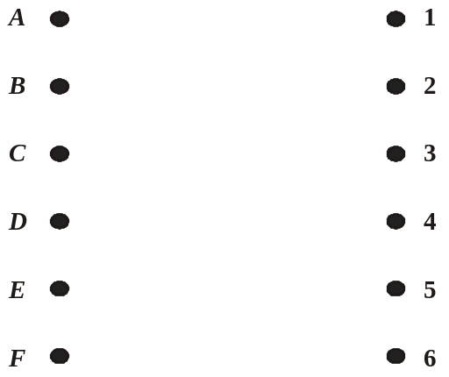



















Matchings
Improved matching
Figure 1
Figure 2
Alternating path
WB14(b) Use the maximum matching algorithm twice to obtain a complete matching. List clearly the alternating paths you use.
Alternating path
Change status
Change status
Improved matching
Complete matching
Alternative solution
F = 5 – A = 6 – D = 2 =B – 4
Complete matching:
A = 6, B = 4, C = 1
D = 2, E = 3, F = 5

Slide 5

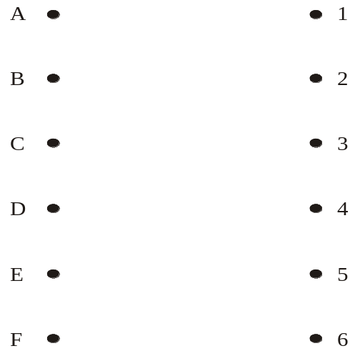






WB15 Six newspaper reporters Asif (A), Becky (B), Chris (C), David (D), Emma (E) and Fred (F), are to be assigned to six news stories Business (1), Crime (2), Financial (3), Foreign (4), Local (5) and Sport (6). The table shows possible allocations of reporters to news stories. For example, Chris can be assigned to any one of stories 1, 2 or 4.
 | 1 | 2 | 3 | 4 | 5 | 6
A
B
C
D
E
F
(a) Show these possible allocations on the bipartite graph on the diagram below.
A possible matching is A to 5, C to 1, E to 6, F to 4
(b) Show this information, in a distinctive way, on the diagram.
(c) Use an appropriate algorithm to find a maximal matching.
You should list any alternating paths you have used.
Alternating path
Change status
Improved matching
(d) Explain why it is not possible to find a complete matching.
3 & 6 can only be done by C

